Slide 1
MODULE -2 Essential Concepts in Political Science

Slide 2
STATE
State: Population residing within a defined territory which is organized under a government having sovereignty.

Slide 3
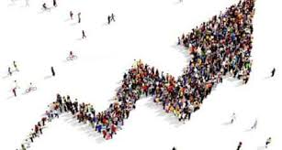
Elements of State
1. Population: all the inhabitants of a particular place

Slide 4
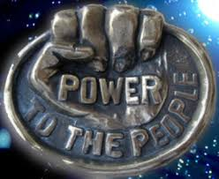
Elements of State
2. Sovereignty: Supreme power or authority.

Slide 5
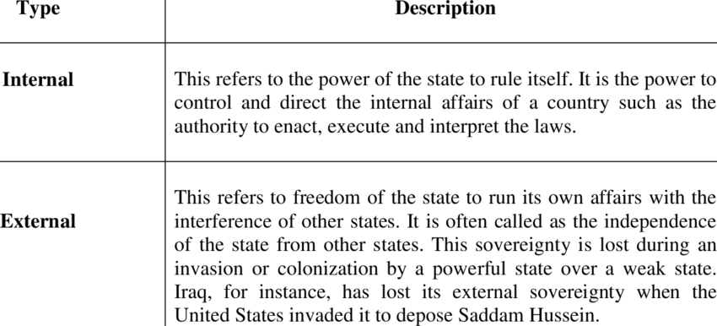
Elements of State
2. Sovereignty: Supreme power or authority.

Slide 6
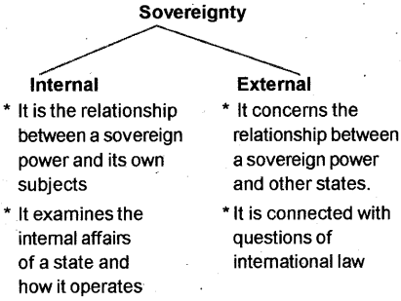
Elements of State

Slide 7
Elements of State
2. Sovereignty: Supreme power or authority.

Slide 8
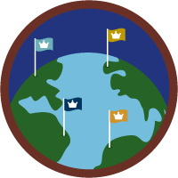
STATE
3. Territory: a geographic area belonging to or under the jurisdiction of a governmental authority .

Slide 9
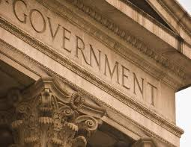
4. Government: the group of people with the authority to govern a country or state

